Slide 1
Faculty Senate Meeting
April 29, 2021

Slide 2
Meeting procedure
The same rules apply over virtual meetings as over in-person meetings
Only Senators may debate motions
Only Senators can vote
If you are not a Senator, or a proxy, you cannot vote or debate
Do not speak over someone, or out of order
  Raise your hand within the Zoom app
  The President will call on you and then you will have the floor
Unless you have been recognized (been told you have the floor), you may not speak

Slide 3
Agenda
Call to Order and Roll Call
K.C. Dolan, Secretary

Slide 4
Agenda
Approval of Minutes
April 29, 2021

Slide 5
Agenda
III. Campus Reports
  A. Staff Council
  A. Kossuth

Slide 6
Agenda
III. Campus Reports
  B. Student Council
  L. Hierlmeier

Slide 7
Agenda
III. Campus Reports
  C. Council of Graduate Students
  J. Valentin-Sivico

Slide 8
Agenda
IV. President’s Report
S. Raper

Slide 9
General Information
Forward Thoughts

Slide 10
Agenda
V. Administrative Reports
A. Chancellor’s Report
M. Dehghani

Slide 11
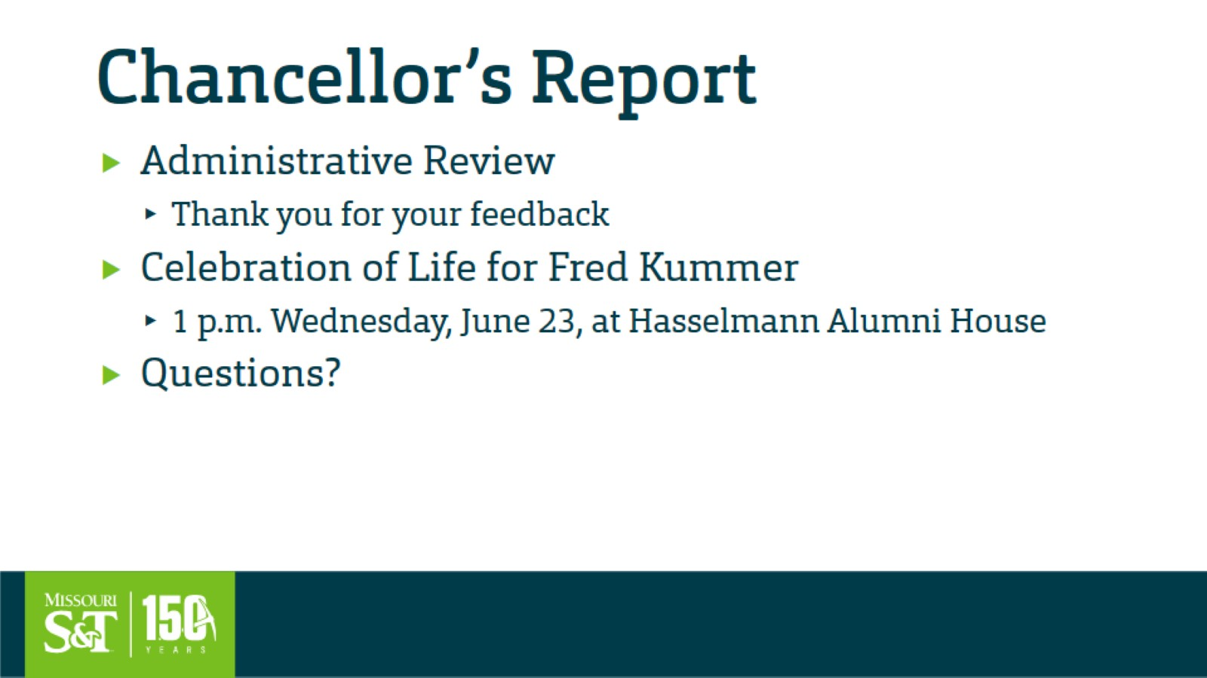
Chancellor’s Report

Slide 12
Agenda
V. Administrative Reports
B. Provost’s Report
C. Potts

Slide 13
Agenda
VI. Reports of Standing Committees
A. Curricula
S. Raper

Slide 14
Campus Curricula Committee Report
10 June 2021
CCC Meetings
-4 May
Total Committee Activity
  13 Course Change Requests (CC Forms)
  39 Program Change Form (PC Forms)
  4 Program Change Form (PC Forms) for administrative/clerical updates only
  2 Experimental Course Requests (EC Forms)

Slide 15
Campus Curricula Committee Report
10 June 2021
Course Changes (CC) Requested
File: 1018.6 CHEM 5810 : Introduction to Polymeric Materials
File: 466.8 CHEM ENG 4301 : Chemical Process Materials
File: 60.1 CHEM ENG 4311 : Professional Practice And Ethics
File: 4800 COMP SCI 5408 : Game Theory for Computing
File: 1237.4 ELEC ENG 5430 : Wireless Networks
File: 4801 ENGLISH 2232 : Comics and Graphic Novels
File: 1944.8 MIN ENG 4096 : Computer Aided Mine Design
File: 754.1 MIN ENG 5822 : Strata Control
File: 1120.1 MIN ENG 6133 : Mine Atmospheric Control II
File: 2176.1 MIN ENG 6735 : Sustainability In Mining
File: 4315.3 MIN ENG 6912 : Advanced Simulation of Mining Systems
File: 1501.1 MIN ENG 6936 : Surface Mine Design
File: 2371.6 NUC ENG 4496 : Nuclear System Design I

Slide 16
Campus Curricula Committee Report
10 June 2021
Program Changes (PC) Requested
File: 146.27 BIO SC-BA : Biological Sciences BA
File: 148.42 BUS&MS-BS : Business and Mgmt Systems BS
File: 255.22 BUSAPPS-MI : Business Applications and Software Development Minor
File: 14.16 CH ENG-MS : Chemical Engineering MS
File: 15.12 CH ENG-PHD : Chemical Engineering PhD
File: 16.34 CHEM-BS : Chemistry BS
File: 24.2 COMM ST-MI : Communication Studies Minor
File: 247.22 CYBERMG-MI : Cybersecurity Management and Information Assurance Minor
File: 40.8 E&S COM-MI : Elect & Social Commerce Minor
File: 38.30 ECON-BA : Economics BA
File: 39.20 ECON-BS : Economics BS
File: 47.4 ENG MG-PHD : Engineering Management PhD
File: 374.8 ENGL TC-BS : English & Technical Communication BS

Slide 17
Campus Curricula Committee Report
10 June 2021
Program Changes (PC) Requested
File: 50.8 ENTPRNS-MI : Entrepreneurship Minor
File: 256.9 FIN TCH-MI : Minor in Financial Technology, Analytics and Transformation
File: 259.6 GAME-MI : Game Studies (Minor)
File: 156.48 GE ENG-BS : Geological Engineering BS
File: 64.52 GL&GPH-BS : Geology and Geophysics BS
File: 166.25 GL&GPH-MS : Geology and Geophysics MS
File: 271.8 GL&GPH-PHD : Geology and Geophysics PhD
File: 235.7 HUM ENG-MI : Humanitarian Engineering and Science Minor
File: 75.32 IST-BS : Information Science and Tch BS
File: 77.2 L COMM-MI : Leadership Communication Minor
File: 138.13 MGMT-MI : Management Minor
File: 101.7 MOBLB&T-MI : Mobile Bus & Digital Transformation
File: 104.18 NU ENG-BS : Nuclear Engineering BS

Slide 18
Campus Curricula Committee Report
10 June 2021
Program Changes (PC) Requested
File: 108.45 PE ENG-BS : Petroleum Engineering BS
File: 171.8 PE ENG-MS : Petroleum Engineering MS
File: 115.41 PHYSIC-BS : Physics BS
File: 344 PROPOSED : Education BS
File: 345 PROPOSED : Water Science and Engineering
File: 258.3 SOC MED-MI : Minor in Social Media in Industry
File: 133.13 TCH CM-MIG : Technical Communication Minor
File: 135.18 TCH COM-MS : Technical Communication MS
File: 296.2 DIGITMD-CT : Digital Media & Web Design CT
File: 298.10 E&S COM-CT : Elec & Social Commerce CT
File: 300.2 HCI-CT : Human Computer Interaction CT
File: 302.12 MOBLB&T-CT : Mobile Business and Digital Transformation CT
File: 303.2 TCH COM-CT : Technical Communication CT

Slide 19
Campus Curricula Committee Report
10 June 2021
  For Informational Purposes; No Senate Approval Required
Experimental Courses (EC) Requested
File: 4803 GEO ENG 5001.006 : Remote Sensing Methods in Hydrology
File: 4802 MIN ENG 5001.001 : Simulation of Mining Systems

Slide 20
Campus Curricula Committee Report
10 June 2021
  For Informational Purposes; No Senate Approval Required
Program Courses (PC) Requested for administrative/clerical updates only
File: 253.16 AI-MI : Minor in Artificial Intelligence and Machine Learning in Business
File: 295.19 CYBERMG-CT : Cyber Mgmt & Info Assurance CT
File: 73.12 IS&T-MS : Info Science & Tech MS
File: 81.18 MARKET-MI : Marketing Minor

Slide 21
Campus Curricula Committee Report
10 June 2021
Curriculum committee moves for FS to approve the 13 CC and 39 PC form actions
Discussion: Questions or comments?

Slide 22
Agenda
VI. Reports of Standing Committees
B. Facilities Planning
K. Erickson

Slide 23
Facilities Planning Committee Report
Arrival District Progress Update
6/8/21

Slide 24
Major Current Projects Related to Arrival District
Demolition of Bureau of Mines Buildings 1, 2, and 3
Innovation Lab (formerly Student Experience Center) construction
University Drive Construction

Slide 25
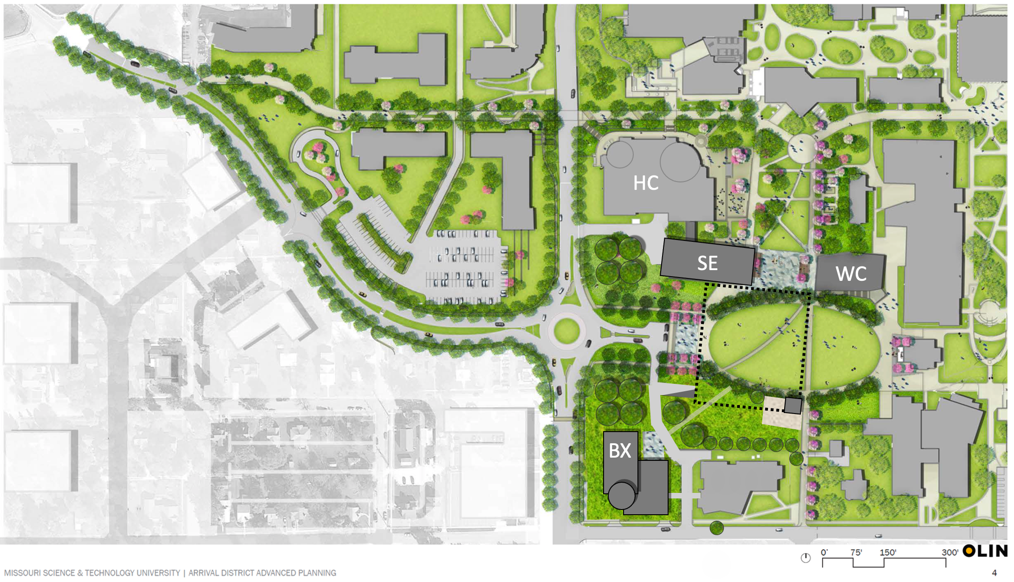
Site Plan
Innovation Lab (formerly Student Experience Center)

Slide 26
Demolition of Bureau of Mines Buildings (BOM) 1, 2, and 3
Abatement scope is complete for all three buildings (some exterior abatement scope will be completed in the demolition contract)
University is in the final stages of negotiations with the State Historical Preservation Office (SHPO) regarding BOM 1
Bids have been received for the demolition, and a low bidder has been identified; the University is waiting to award contract until negotiations with SHPO are further along
Demolition is expected to take 120 calendar days once the contract is awarded to the demolition contractor

Slide 27
Innovation Lab (formerly Student Experience Center)
Project is in design phase
Programming phase is complete, and the project is in schematic design
Vision: create a collaborative community that will transform the intellectual, social, and economic potential of S&T students through world-class events, activities, and resources to create graduates capable of meeting the societal and workforce needs of today and tomorrow.
Mission: provide unique spaces, personnel, and programs that offer critical action-learning opportunities in the areas of research, innovation, creative expression, communication, leadership, teamwork, and entrepreneurism, while focusing on the importance of diversity in the human experience.

Slide 28
Innovation Lab (formerly Student Experience Center)
Currently in progress is the selection progress for a construction manager
  Four finalists have been identified
  Proposals are construction manager at risk are to be received on June 16 and fee negotiations will commence for pre-construction services
  Expected to have the construction manager under contract in July
Building size: currently 51,500 gross square feet

Slide 29
University Drive and Roundabout Construction
Contract awarded by the City of Rolla to a contractor
Construction completion scheduled for Spring 2022
  Schedule submittal to follow from the successful contractor

Slide 30
Agenda
VI. Reports of Standing Committees
C. Budgetary Affairs
M. Fitch

Slide 31
Budgetary Affairs Committee
Jun 10, 2021
Referrals
Continuing referrals:
Report on the “big picture balance sheet”
Current and next FY budget
Non-referral
Salary changes (old referral)

Slide 32
Budget
Current FY budget remains on target
  Met tuition target
  State restricted purpose appropriation = $4.6 MM, majority for Power Plant demo, some for substation.
  Magnitude of carryforward unclear, depends on timing of Federal funds (reimbursements)

Slide 33
General Revenue Budget
~$58,000,000 of budget is not general revenue (Grants & Contracts)
Change included distance tuition shift = + $1-2 MM, so at least $7 MM decline
 | FY19 | FY20 | FY21 (budgeted) | FY 22 (planning)
Tuition and Fees | $124,548,154 | $126,853,439 | $120,891,674 | $119,592,4250
Scholarship Allowance | (37,770,678) | (37,848,888) | (42,105,102) | (38,164,248)
Net Tuition & Fees | $86,777,476 | $89,004,551 | $78,786,571 | 81,428,177
State Appropriation | 50,185,510 | 43,543,499 | 43,560,524 | 53,026,096
Grant and Contract | 0 | 0 | 0 | 0
Gift Revenues | 481,131 | 385,737 | 317,500 | 345,000
Recovery of F & A | 6,941,286 | 6,802,499 | 6,099,000 | 6,493,100
Endowment & Investment Income | 1,969,324 | 2,035,737 | 1,496,386 | 3,120,243
Sales & Services Income | 989,382 | 1,177,479 | 1,093,340 | 1,065,880
Other Incomes | 3,464,299 | 2,872,553 | 3,283,657 | 2,958,389
Revenue Contingency | - | - | (938,512) | -
Total Revenues | $150,808,407 | $145,822,055 | $133,698,466 | $148,437,385
Trend: 30%, 30%, 35%, 31%
UM System pass through, State +1.3MM
$5 M
$12.1 M

Slide 34
General Revenue Budget: costs
Total Revenues | $150,808,407 | $145,822,055 | $133,698,466 | $133,980,524
Transfers | FY19 | FY20 | FY21 (budgeted) | FY 22 (planning)
Intra Unrestricted CurrentFund | $6,755,777 | $4,442,960 | $195,883 | $1,581,686
Mandatory Transfers | (3,778,102) | (3,930,896) | (3,612,726) | (3,197,402)
NonMandatory Transfers | (11,607,554) | (6,885,979) | 1,509,153 | (3,446,690)
Total Transfers | ($8,629,879) | ($6,373,915) | ($2,299,456) | ($5,062,406)
Expenditures
Salaries & Wages | $83,651,987 | $80,232,396 | $77,824,286 | $79,426,854
Benefit Expense | 25,475,433 | 25,029,887 | 26,311,435 | 26,626,149
Compensation | $109,127,420 | $105,262,283 | $104,135,721 | $106,053,0030
Other Expenses | 38,416,204 | 33,205,855 | 27,882,045 | 37,256,650
Total Expenditures | $147,543,624 | $138,468,138 | $132,017,766 | $143,309,653
Paying loans
CARES funds, mostly IT investment
$3.42 M
$2.41 M
2% raise, $250K P&T
Changed basis
Return to pre-COVID
UM System ~2.7MM

Slide 35
Executive/admin
Salaries
Summer 2020, 3 months at -10% for 11 admin: Chancellor, VCs, Provost, Deans, DP, AP
Chancellor raise March 1: $100,000 (25%)
Dir II Strategic Communication to aVC Jan 1: $35,920 (32%)
CDO position from Director II (iCDO): $23,843 (23.6%)
CASB Dean shuffle: slight decrease in total, individuals +40%, +26%

Slide 36
Chancellor positions
Position | AY 20-21 |  | AY 19-20 |  | AY 18-19 |  | AY 17-18
Chancellor | Dehghani | +25% | Dehghani | +40% | Maples | +1.8% | Maples | -18%
Provost | Roberts |  | Roberts | +0.1 | Marley |  | Marley
VC R&DGS | Tsatsoulis |  | Tsatsoulis |  | Tsatsoulis | +30.5 | Crow
VC Adv | Nesbitt |  | Nesbitt | +1.9 | Nesbitt | +4.9 | Nesbitt
VC F&O | Plain |  | Plain | +1.3 | Plain | +1.75 | Plain | -4.0
VC SA | Robinson |  | Robinson | +2.1 | Robinson | +1.5 | Robinson
CDO | Rivera*/Outar | -9.0 | Outar | +23.6 | Outar* | +1.16 | Outar* | -40
CIO | Bookout | +9.4 | Bookout | -7.4 | Uetrecht | +1.9 | Uetrecht | +32.3
aVC | Careaga | +32.2 | Careaga | +3.7 | Careaga | +4.77 | Careaga | +0.5
SUM | $1,840,621 | +3.0 | $1,786,828 | +9.0 | $1,639,679 | +6.05 | $1,546,128 | -7.75
*Not official title; official title Director

Slide 37
Provost positions
Position | AY 20-21 |  | AY 19-20 |  | AY 18-19 |  | AY 17-18
Provost | Roberts |  | Roberts | +0.1 | Marley |  | Marley
CEC Dean | Wlezien |  | Wlezien |  | Wlezien | +1.4 | Wlezien
CASB Dean | Drowne |  | Drowne | -1.6 | Roberts | +3.25 | Roberts
Dep Prov^{a,b} | Brow |  | Brow | +100
VP Enroll | Sivadasan |  | Sivadasan | +36.6 | Albers | +2.48 | Albers
VP Acad | Northcut |  | Northcut | -21 | Cawlfield | +1.55 | Cawlfield
VP Global |  |  |  |  |  | -100 | Petroy
VP Int’l Af | Hofer |  | Hofer | +1.5 | Hofer |  | Hofer
AP Admin | Moore |  | Moore | +5.0 | Moore | +22.5 | Moore
AP Fac Af^{a,b} | Forciniti |  | Forciniti | +11.7 | Forciniti | +16.1 | Mormile
Spec Asstª | Stone | -2.3 | Stone | +136.8 | Stone | +100
SUM | $1,313,028 | +0.41^{c} | $1,307,666 | +5.85 | $1,235,340 | -10.6 | $1,333,279
ªNot official title; official title Professor
^{b}Fractional appointment assumed 25%
^{c}Summer 10% cut artefact

Slide 38
Directors
Reclassifications = promotions:
Budget director $18,575 (22%)
Police chief $11,400 (10.4%)

Slide 39
Chairs
AY 20-21 no increases except
Congratulations, Kwame to Professor (officially MNE no Chair last 3 yrs)
AY 19-20, 1.5 – 2.6% except: 1 of 11 in CASB and 4 of 9 in CEC:
ALP: + 6.6% AY 20-21
CArE: +4.1% Merit, AY 19-20
ECE: +3.3% Merit, AY 19-20
GGPE: +5.5% AY 19-20
MNE: +5.6% AY 19-20
Ignores 10 chairperson changes in last two years (Econ, History, Math, TEC, ChE x 2, Comp Sci x 2, MAE, MNE)
Ignores ROTC commanders, not S&T funded

Slide 40
Faculty*
*Did not include Lecturers, Research NTT, Chancellor’s profs in numbers
AY 2020-2021
0% raise, few merit, several promotions (+10K for P, +6K for TP, +5K for AP, +3K for ATP)
CS, two aP in second year: +12.5%, + 50%
GGPE one P +1.2%, one P +7.8%
MSE one P -7.7%, one +10%
MAE: one P -5.2%, one AP +6%
AY 2019-2020
Dep’ts varied, instructed to use 1.5% for all, then 0.5% to top quarter
  Dominant model was 1-1.5% for many, 3-6% for the rest
  All 1.5% except one/few below 1% and one/two above 5% (ChE, MAE)
  0% for a few, 2-4% for the rest (ALP)
  0.5-1.5% for most, 5-8% a few (Emgt, GGPE, MNE)
  1.5% several, 2.0% several, 5% one, 30% one (CS, much churn)
One MAE AP +9.4%; two MSE P +10%

Slide 41
Faculty
*Did not include Lecturers, Research NTT, Chancellor’s profs in numbers
Dept | ALP | Bio | BIT | Chem | ChE | CArE | CS¹ | Econ | ECE | EMgt | Engl | GGPE | Hist | Math | MSE | MAE | MNE | Phys | Psych | TEC
Net | -3 | 0 | 0 | -6 | 0 | +1 | +4 | -1 | -5 | -2 | -1 | -2 | 0 | -3 | -2 | -5 | -6 | -3 | 0 | +3
’18 | 20 | 12 | 17 | 24 | 16 | 28 | 17 | 9 | 36 | 16 | 17 | 22 | 13 | 24 | 20 | 39 | 17 | 19 | 12 | 2
’19 | 18 | 11 | 18 | 21 | 16 | 28 | 18 | 8 | 33 | 17 | 17 | 22 | 13 | 22 | 19 | 33 | 15 | 16 | 11 | 3
‘20 | 17 | 12 | 17 | 18 | 16 | 29 | 21 | 8 | 31 | 14 | 16 | 20 | 13 | 21 | 18 | 34 | 11 | 16 | 12 | 5
¹Frimpong in MNE
2018-19 AY, 380 faculty, 31 fewer now (-8%)

Slide 42
Agenda
VI. Reports of Standing Committees
D. Information Technology
J. Singler

Slide 43
Outline:
  IT budget discussion with Cuba Plain in May ITCC meeting
  Brief updates on faculty senate referrals
    Greenscreen classrooms
    myVITA
    Note: Still waiting on modified draft campus policy for surveillance cameras
Details below!

Slide 44
IT budget discussion in May with Cuba Plain
  Current effort to increase IT salaries toward market level, for current and open positions
    Need to build up IT staff salary numbers
    Hard to fill open positions due to low salaries – this is a problem here and at many other universities
  One-time Coronavirus money being used for IT infrastructure
    Such one-time money will not be used for salaries since it cannot be budgeted for the future

Slide 45
IT budget discussion in May with Cuba Plain
  New draft of Desktop Enhancement (DE) program begin developed
    Still many details to work out, ITCC will provide feedback
    4-year replacement cycle
    Each machine will come with a 4-year warranty – in general, IT will only work on machines under warranty
    Current model that IT works on anything is not sustainable – IT currently invents a massive amount of staff time in working on old machines that are out of warranty

Slide 46
IT budget discussion in May with Cuba Plain
  Reopening the walk-up IT helpdesk is a top priority
    This will hopefully happen soon, and will no longer require an appointment
    Once staff is built back up, a later focus will be on the call center

Slide 47
Greenscreen classroom FS referral brief update
  Ad hoc committee working on this, waiting for department chair feedback
  Brief current assessment of the committee:
    If used correctly, green screen classrooms provide technical means to produce higher quality content
      This is beneficial for asynchronous teaching, but mainly for content delivered through corporate partnerships (e.g., short courses, online workshops, online classes ‘for sale’)
    For general teaching, green screen rooms do not provide a huge benefit, if faculty are not invested/interested in proper usage

Slide 48
myVITA FS referral:
  How was myVITA chosen?
    Were faculty consulted in the decision?
  How much is being paid and who is paying?
  First, from the April 2014 ITCC minutes and the corresponding ITCC presentation to the FS:
    Wayne Huebner presented to the ITCC and said myVITA was endorsed by IFC and the provosts
    It does not appear that the ITCC was consulted

Slide 49
How was Faculty180/myVITA chosen?
  I contacted UM System IT and received more info:
    Town halls were conducted at all four UM System campuses beginning in Fall 2012
    Academic affairs sent representatives to visit with faculty, deans, and chairs in person on each campus
    IT was not involved in any of the town halls, discussions, or decision making – the UM System CIO, Gary Allen, was looped in after the decision was made
    The UM Academic Affairs VP, Hank Foley, made the decision to purchase

Slide 50
Related: How was the new RPT system chosen?
  UM System IT:
    RPT = Review, Promotion, and Tenure (Interfolio product)
    After 3 years of myVITA, the four myVITA university leaders felt the companion RPT product is preferable
    Interfolio demoed RPT in Fall 2019 to these leaders, campus myVITA coordinators, and a representative group of faculty – they felt RPT is superior for many types of reviews, especially P&T
    RPT was purchased 12/2019, and is now required to be used for P&T cases
      RPT is accessed in myVITA, left navigation, toward the bottom

Slide 51
How much is being paid and who is paying?
  UM System IT:
    UM System paid $394K for Interfolio (myVITA + RPT) this fiscal year
    UM System is budgeting $423K for next fiscal year
    Before adding RPT, the cost was about $250K
    These costs are included in the Administrative Systems Budget, which includes PeopleSoft, etc.
    That entire budget is split across the four campuses, and in some cases the university hospital
    The split is based on the percent of overall expenses

Slide 52
Agenda
VI. Reports of Standing Committees
E. Public Occasions
S. Sedigh Sarvestani

Slide 53
Public Occasions Committee Report
Dr. Sahra Sedigh Sarvestani, Chair
Motion: Approval of 2021-2022 Open House Dates

Slide 54
Motion
The Public Occasions Committee moves that the following Open House dates be adopted for the 2021-2022 academic year:
Fall 2021
Friday, September 10 (potential 3rd date)
Saturday, October 9
Saturday, November 6
Spring 2022
Monday, February 21
Friday, April 15

Slide 55
Agenda
VII. New Business

Slide 56
Agenda
VIII. Adjourn
56

